Slide 1
Lung Cancer Detection System Using CNN Name : Pawan Kumar K.P USN : 4SO23MC068 4th Semester MCA
Internal Guide:
Ms. Sumangala N
Asst Professor
Department of Computer Applications

Slide 2
Introduction to the Project
Abstract / Overview
Lung cancer → leading cause of cancer-related deaths (~25% worldwide).
Late diagnosis → poor prognosis & limited treatment success.
Proposed: Hybrid CNN + VGG16 for early detection from CT scans.
Web-based multi-user platform (Admin, Doctor, Patient).
Dataset: IQ-OTH/NCCD – 9,600 images (Normal, Benign, Malignant).
Achieved 95.25% accuracy after 100 epochs.

Slide 3
Introduction to the Project
Problem Statement
Lung cancer often detected in late stages → 1.8M deaths/year.
Traditional methods (biopsy, bronchoscopy, CT) → costly, invasive, need expert radiologists.
Shortage of specialists → delays & errors.
Radiological interpretation variability up to 20% in complex cases.
Need: Non-invasive, accurate, accessible, AI-based detection system.

Slide 4
Introduction to the Project
Significance / Objectives
Enable early detection → better treatment outcomes.
Provide cost-effective, scalable diagnostic tool.
Reduce workload of radiologists via AI decision-support.
Role-based system for healthcare workflow integration.

Slide 5
Software Requirement Specification
System Requirements (Functional)
User registration/login.
Image upload & preprocessing.
CNN-VGG16 prediction (Normal / Benign / Malignant).
PDF report generation with recommendations.
Role-based access (Admin, Doctor, Patient).

Slide 6
Software Requirement Specification
Non-Functional Requirements
Performance: Fast predictions (~4.7 sec).
Security: Encrypted storage, hashed passwords, role-based access.
Scalability: Modular architecture.
Usability: Responsive, user-friendly web interface.

Slide 7
Software Requirement Specification
Project Scope & Benefits
Scope: Web-based AI tool for lung cancer detection from CT scans.
Benefits:
Early detection & improved prognosis.
Reduced manual workload.
Low-cost solution using open-source tools.

Slide 8
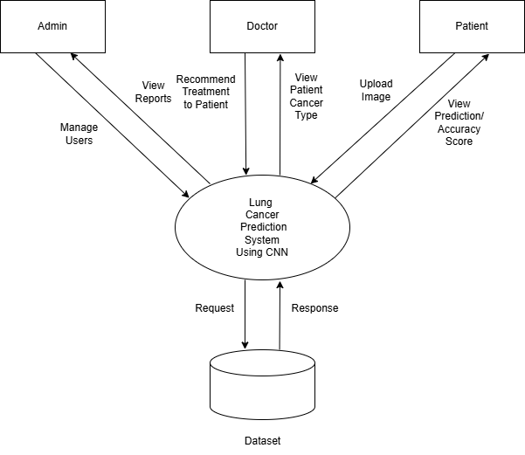
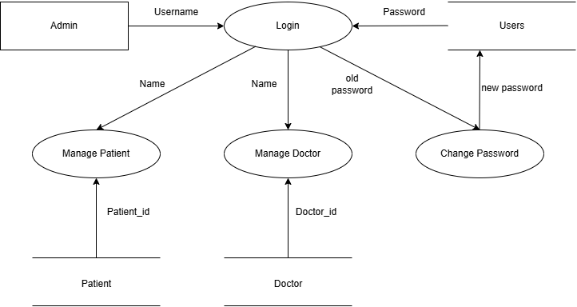
Design Documents
Context Flow Diagram
Admin DFD

Slide 9
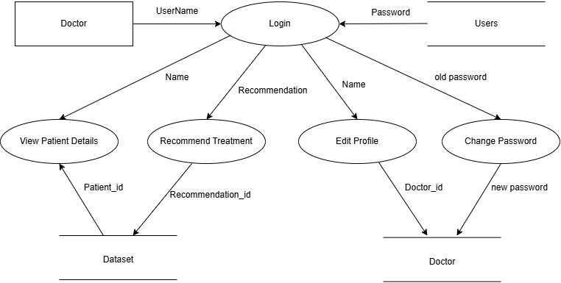
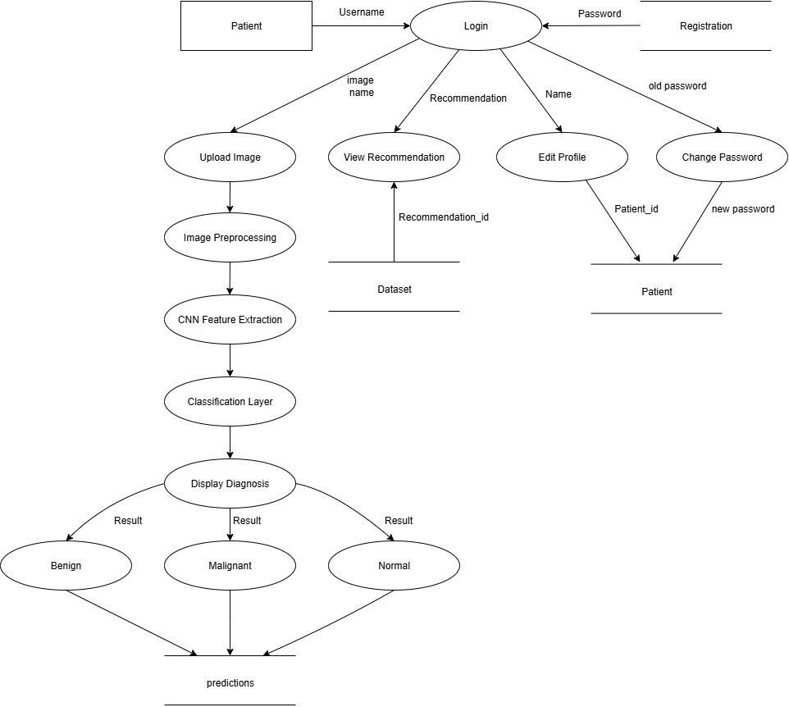
Design Documents
Doctor DFD
Patient DFD

Slide 10
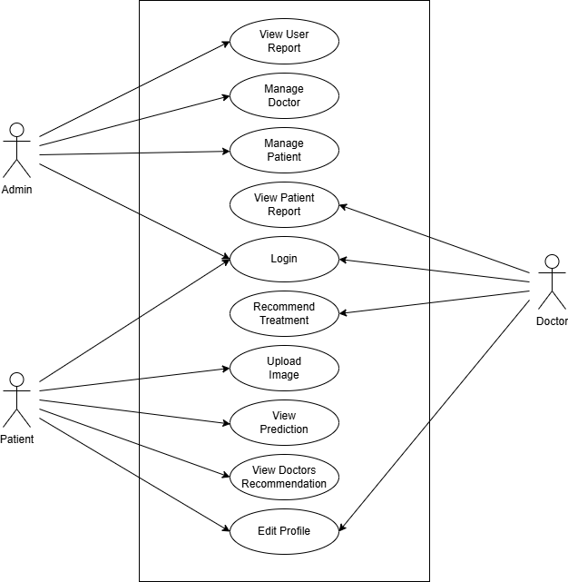
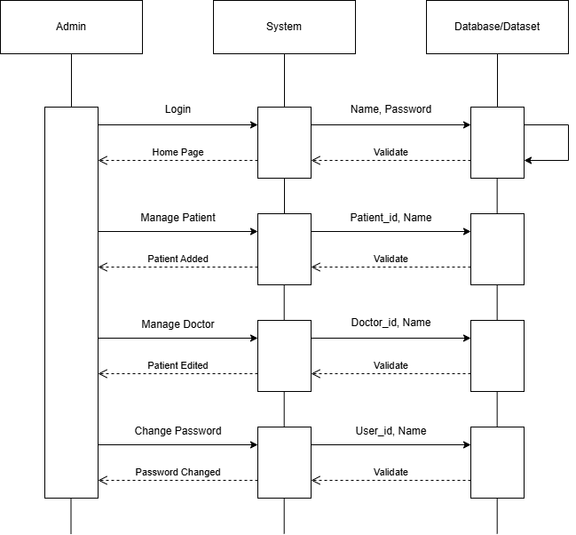
Design Documents
Use Case Diagram
Admin Sequence Diagram

Slide 11
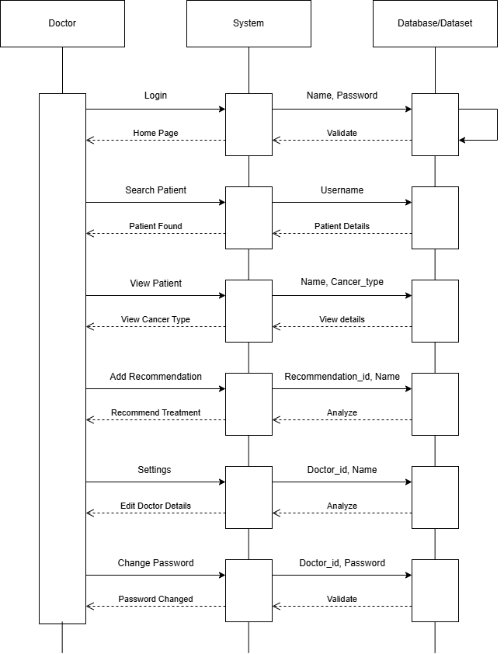
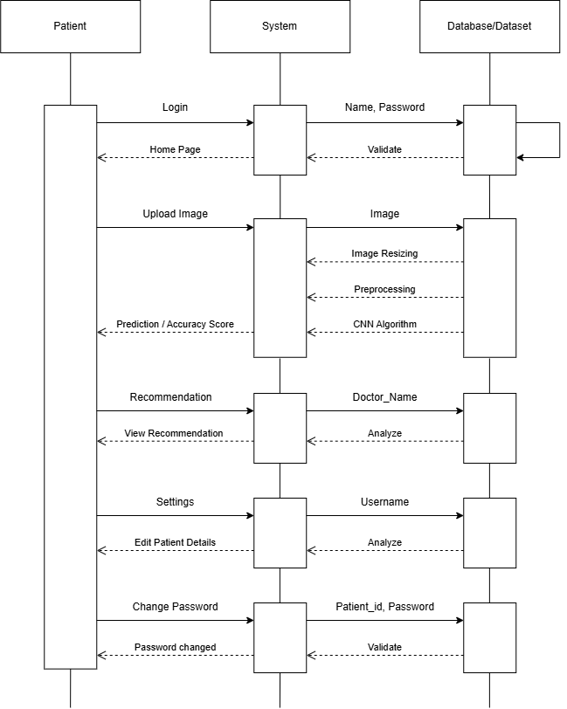
Design Documents
Doctor Sequence Diagram
Patient Sequence Diagram

Slide 12
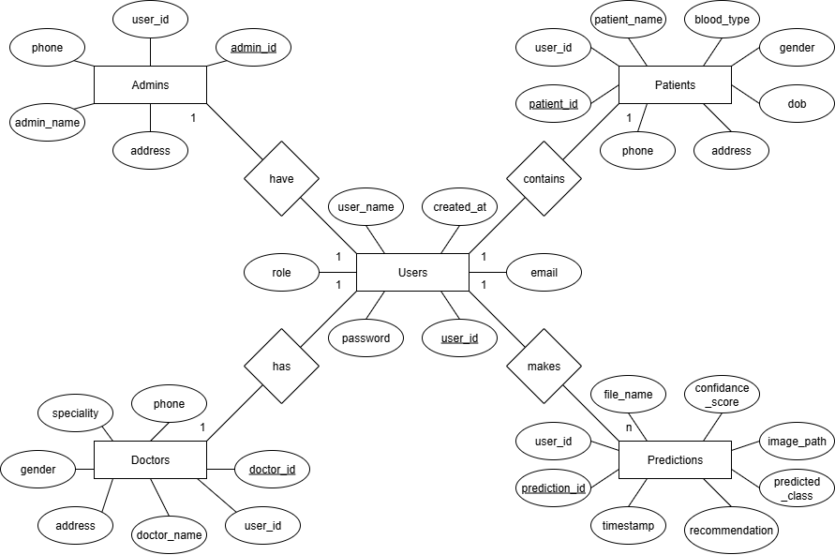
Design Documents
ER - Diagram

Slide 13
Testing
Unit Testing: Verified login, image upload, prediction output.
Integration Testing: Verified interaction between modules.
Accuracy: 95.25% with validation set.
Cross-validation confirms stability (±1.3%).

Slide 14
Testing
Tests cases | Inputs Given | Description of the Test | Output
1 | If any field found empty | Each value must be filled. | All values must be entered.
2 | Username is Text | Valid username needed to be entered | Enter genuine username
4 | If Password is blank | Password is empty | Enter the password
5 | Password Confirmation does not congruent | The right password should be used | Mismatched password is detected
6 | Valid input | Valid input | Registrations successful
Test cases | Inputs Given | Descriptions of the Test | Output
1 | Required fields are not packed out | Mandatory fields must not be left blank | Displays an error message as expected
2 | A duplicate entry is provided | Duplicate entries should be disallowed | Displays an error message as expected
Integration Test Cases for Data Insertion
Unit Testing for registration

Slide 15
Implementation
Algorithm (CNN Pipeline)
Resize (224×224)
Normalize (0–1)
Augment (rotation, flip, scale)
Feature extraction (VGG16 pre-trained)
Dense layers + Softmax
Prediction stored in DB.

Slide 16
Implementation
Preprocessing
Contrast enhancement (10%).
Random augmentation.
Avoid overfitting.
Tools Used
Frontend: HTML, CSS, JS
Backend: Flask, Python, MySQL
Dev: VS Code, PyCharm, XAMPP

Slide 17
Implementation
Begin
Input: High-resolution CT-Scan images
Preprocess the images:
Apply normalization
Perform noise reduction
Apply contrast enhancement
Standardize image size and resolution
Extract features:
Identify texture, shape, density, and cancer size
PSEUDO CODE FOR LUNG CANCER DETECTION
Analyze using Convolutional Neural Network (CNN) features:
Classify cancer as benign or malignant based on trained dataset
If cancer is malignant:
Recommend further medical evaluations and treatment
Else if cancer is benign:
Suggest routine monitoring and preventive measures
End

Slide 18
Lung Cancer Detection System Using CNN and Machine Learning Algorithms (Research Paper)
Abstract:
Lung cancer is a leading cause of cancer-related deaths globally.
Early detection is critical for improving survival rates.
Proposed: CNN-based approach integrating VGG16 for classification of CT scan images into Normal, Benign, Malignant.
Web-based platform supports Admin, Doctor, Patient roles for real-world usability.
Achieved 95.25% accuracy on IQ-OTH/NCCD dataset after 100 training epochs.

Slide 19
Lung Cancer Detection System Using CNN and Machine Learning Algorithms (Research Paper)
Objectives:
Enable early and accurate detection of lung cancer from CT scans.
Provide a cost-effective, scalable AI-based solution.
Reduce diagnostic delays by assisting radiologists in decision-making.
Implement a role-based web system with user authentication, prediction storage, and PDF report generation.
Validate performance using accuracy, sensitivity, specificity, and F1-score.

Slide 20
Lung Cancer Detection System Using CNN and Machine Learning Algorithms (Research Paper)
Methodology:
Dataset: IQ-OTH/NCCD – 9,600 images (Normal / Benign / Malignant).
Preprocessing: Resizing (224×224), normalization, data augmentation.
Model: VGG16 base (pre-trained on ImageNet) + custom dense layers + Softmax.
Training: Adam optimizer, Sparse Categorical Crossentropy loss, 100 epochs, 80:20 split.
Evaluation: Tested on unseen images, metrics recorded.
Conclusion:
Model achieved 95.25% accuracy, outperforming several existing methods.
Fast prediction time (~4.7s) makes it suitable for clinical workflows.
Demonstrates strong potential as a decision-support tool, not a replacement for radiologists

Slide 21
Results & Discussion
Performance Metrics
Accuracy: 95.25%
Sensitivity: 95.1%
Specificity: 97.3%
F1-Score: ~94–96%.
Key Metric Formulas
Accuracy = (TP + TN) / (TP + TN + FP + FN)
Sensitivity (Recall) = TP / (TP + FN)
Specificity = TN / (TN + FP)
F1-Score = 2 × (Precision × Recall) / (Precision + Recall)

Slide 22
Results & Discussion
Class-wise Metrics:
System Performance
Image upload: 2.3s
Prediction: 4.7s
DB query: 0.8s
Class | Accuracy | Sensitivity | Specificity | F1-Score
Normal | 96.2% | 95.8% | 96.5% | 96%
Benign | 94.1% | 93.7% | 94.4% | 94%
Malignant | 95.4% | 96.2% | 94.8% | 95%

Slide 23
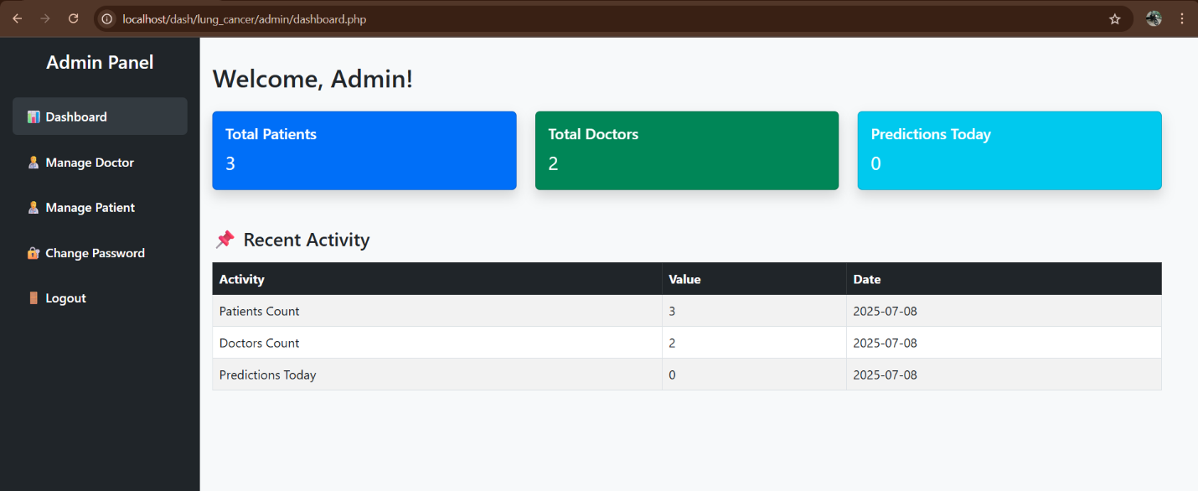
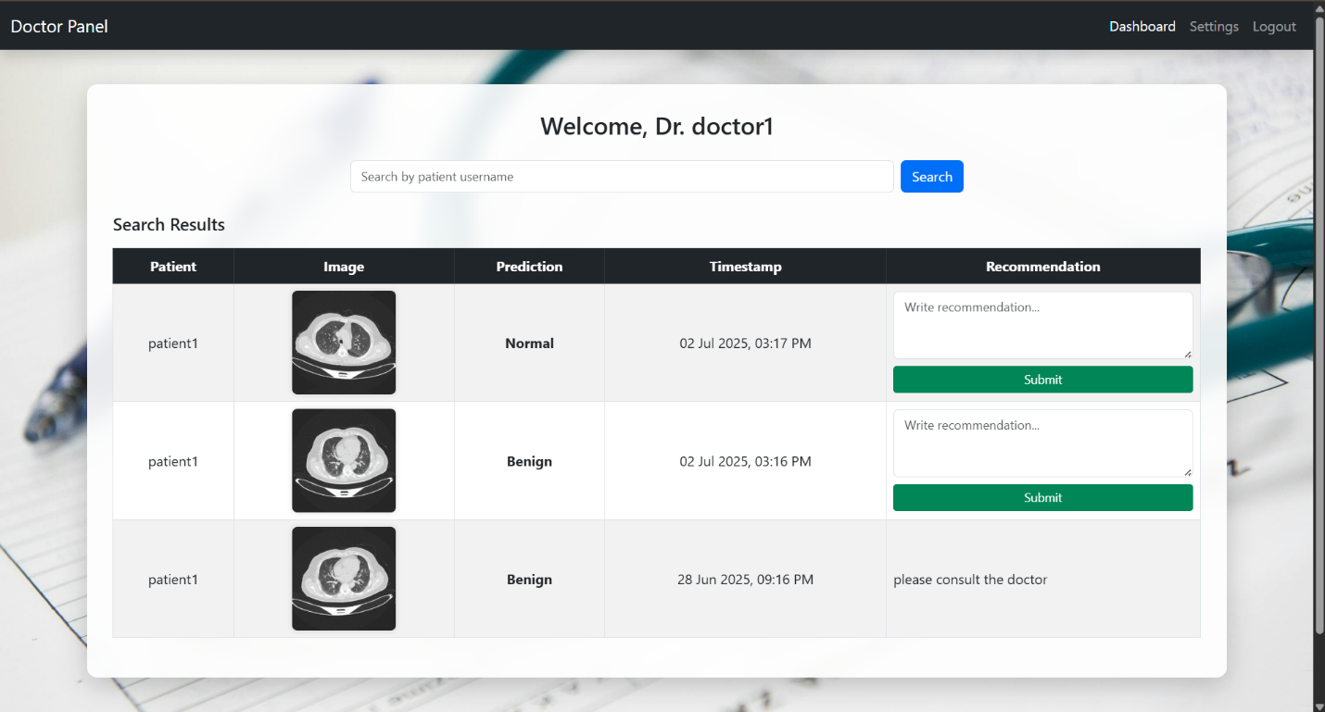
Screenshots
Admin Dashboard
Doctor Home Page

Slide 24
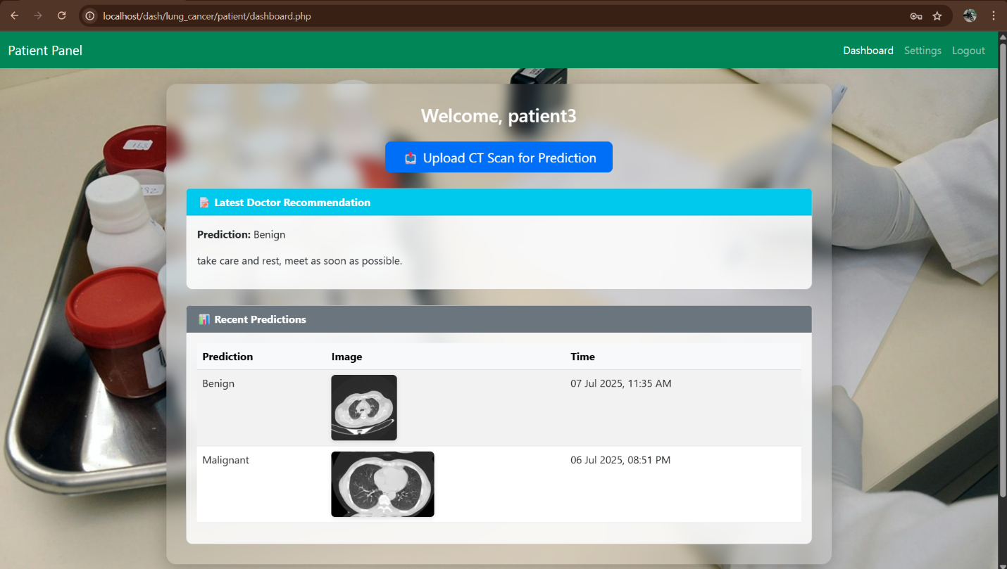
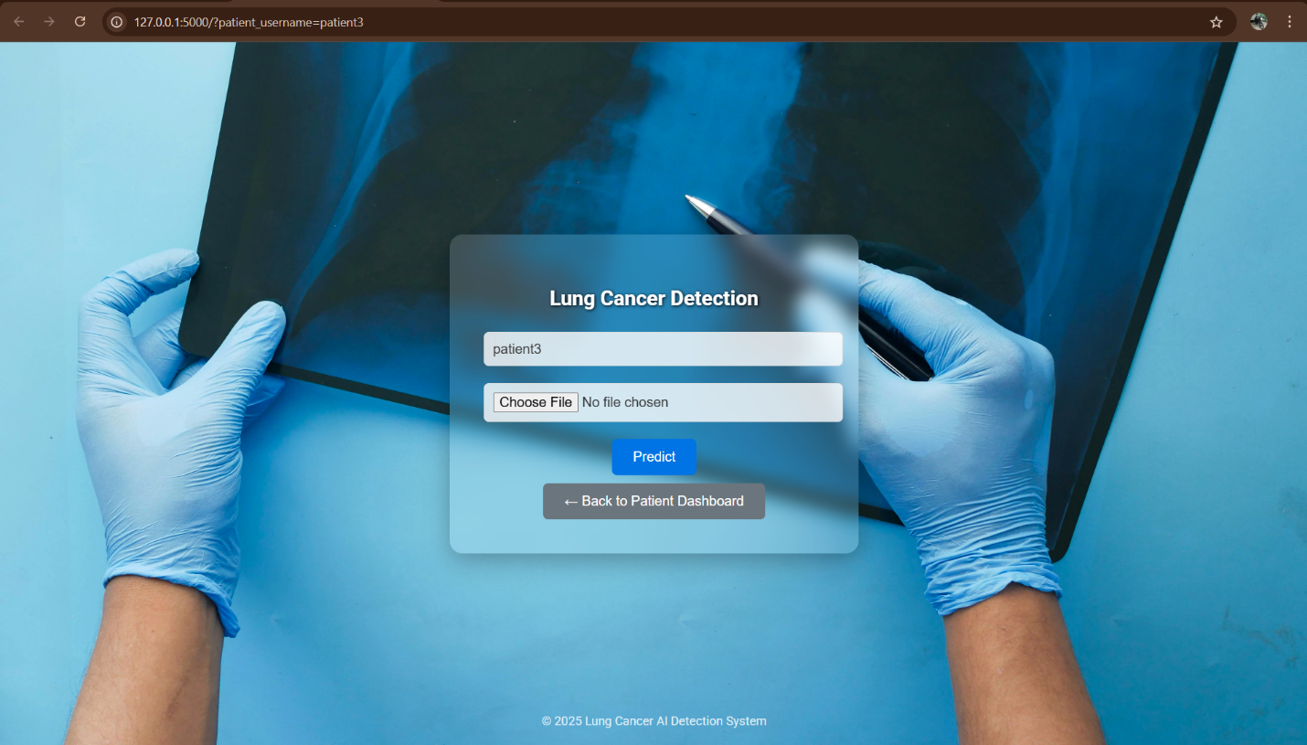
Screenshots
Patient Home Page
ML Prediction Page

Slide 25
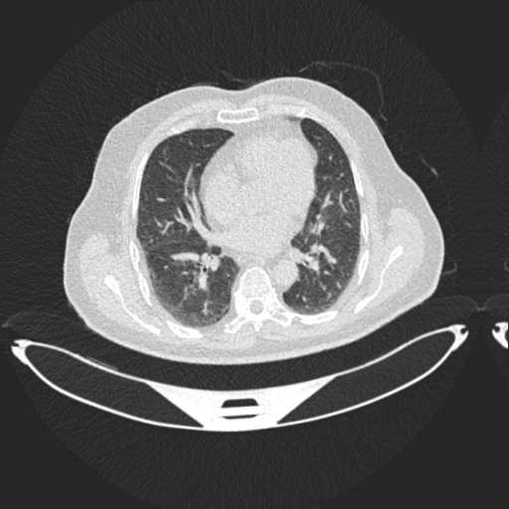
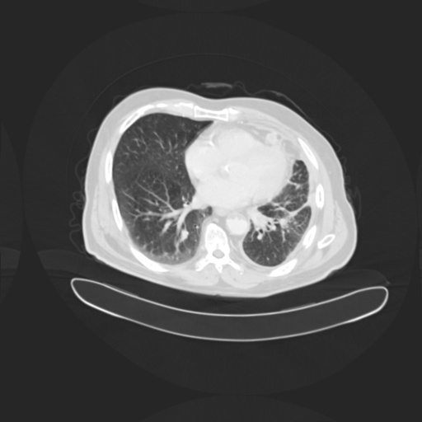
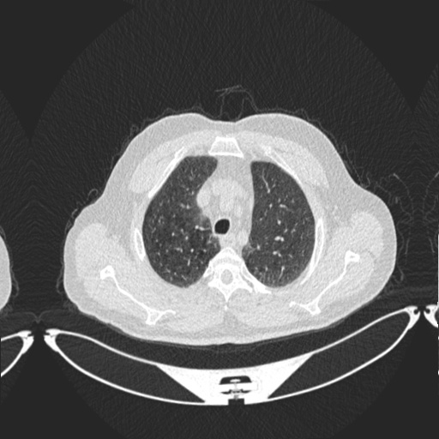
Screenshots
CT-Scan for Benign Case
CT-Scan for Benign Case
CT-Scan for Benign Case

Slide 26
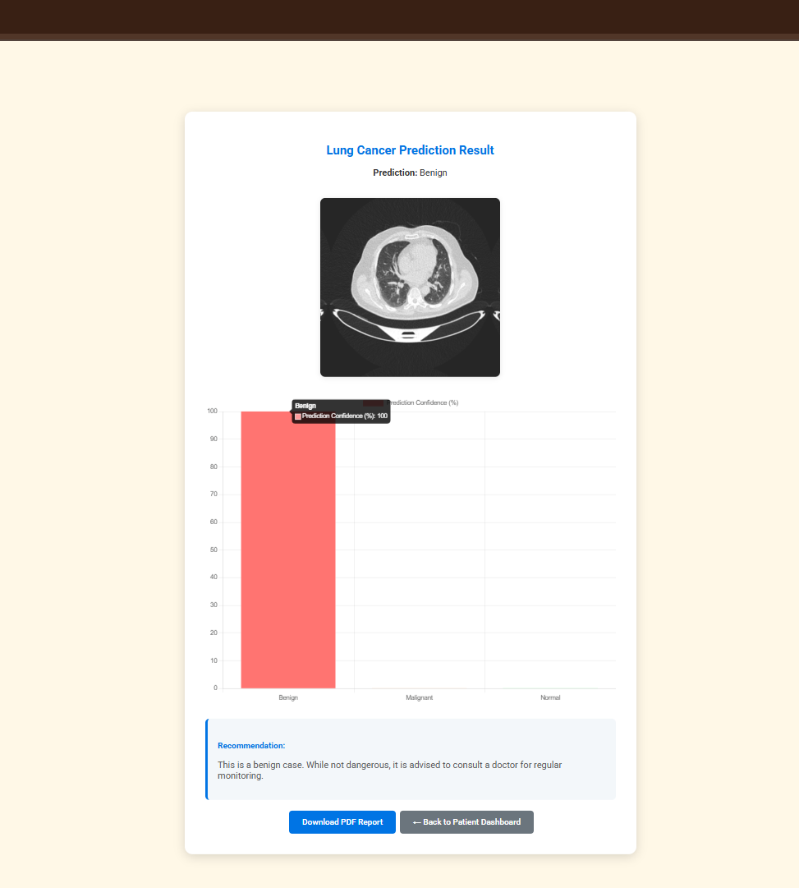
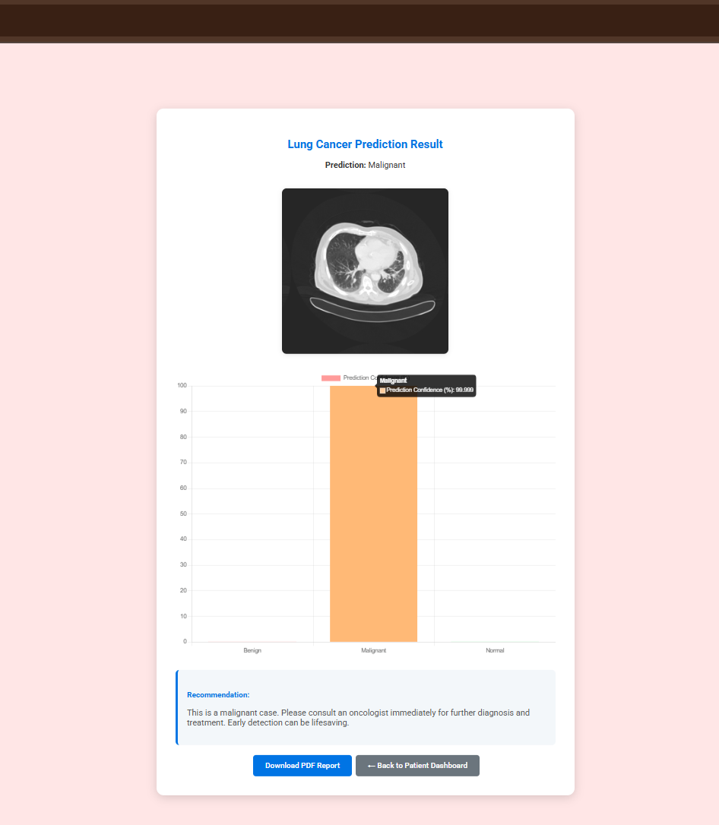
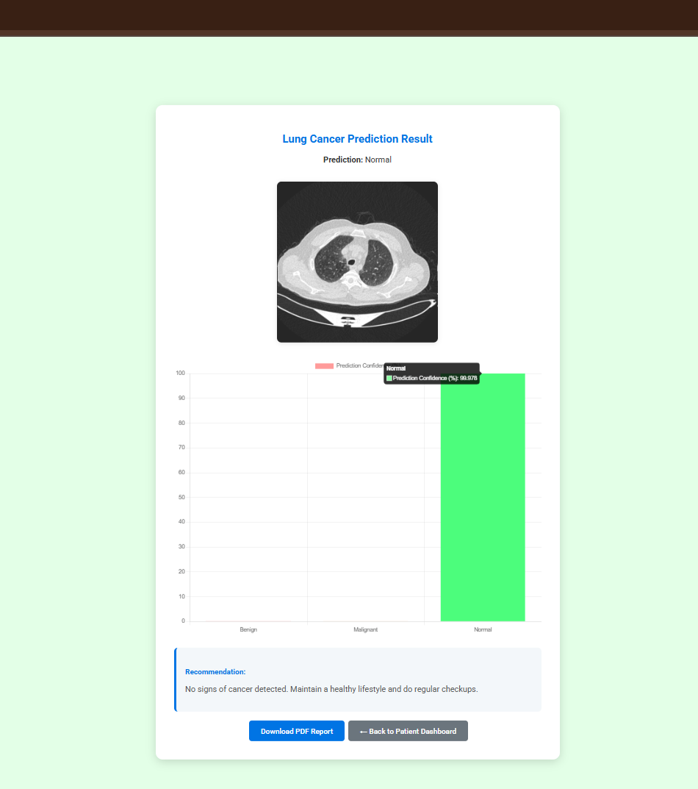
Screenshots
Benign Case Prediction
Malignant Case Prediction
Normal Case Prediction

Slide 27
Thank You

